Slide 1
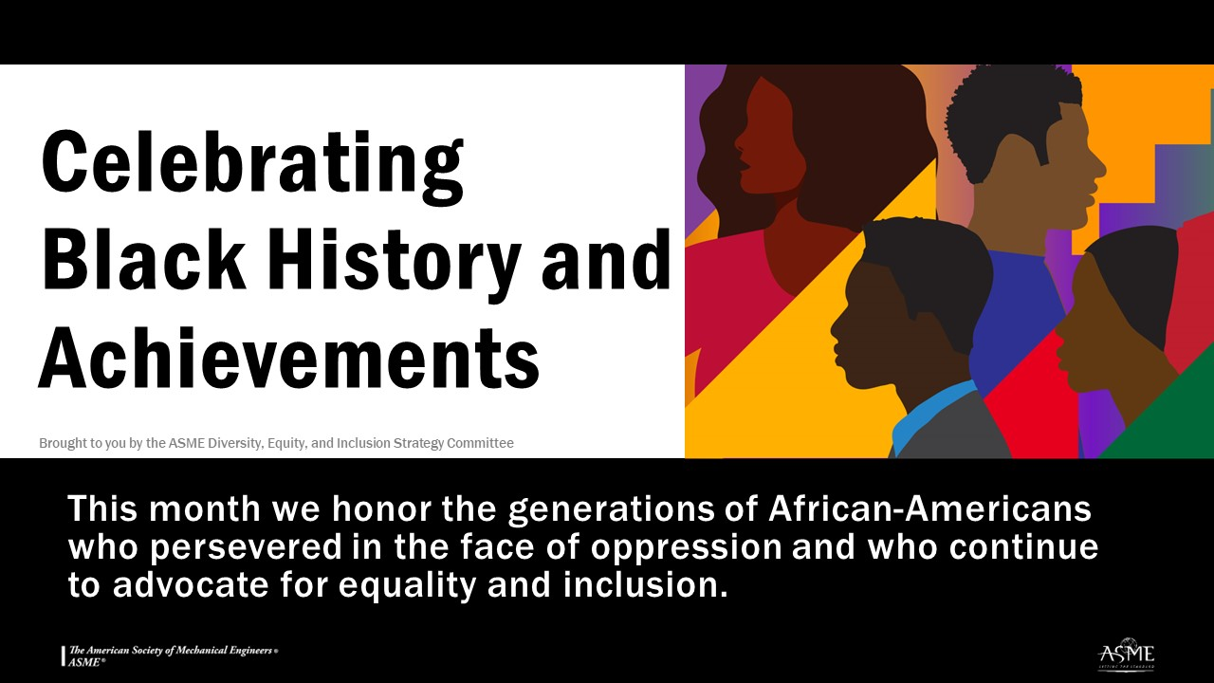
Notes:
Today's DEI Moment focuses on Celebrating Black History and Achievements because the United States has designated the month of February as Black History Month, which has been observed in one form or another since 1926 when American educator and historian Carter G. Woodson, founder of the Association for the Study of African American Life and History, designated a week in February to focus on African American history.
He chose the week that included the birthdays of President Abraham Lincoln and the abolitionist writer Frederick Douglass. Woodson recognized that history confers power and sought to bring to light a history that was largely left out of school curricula. The week was expanded to a full month in the 1970s, and in 1976, U.S. President Gerald Ford recognized Black History Month during the country’s bicentennial celebrations.
In ASME, we can take Black History Month as an opportunity to highlight and celebrate the accomplishments of our Black and African American members and staff, and the contributions of Black engineers to the profession more broadly. I encourage each of you to set aside some time this February to learning and reflecting on the contributions of Black people in our society.

